Slide 1

Copying Nested JSON to SQL Database
Azure Data Factory

Slide 2
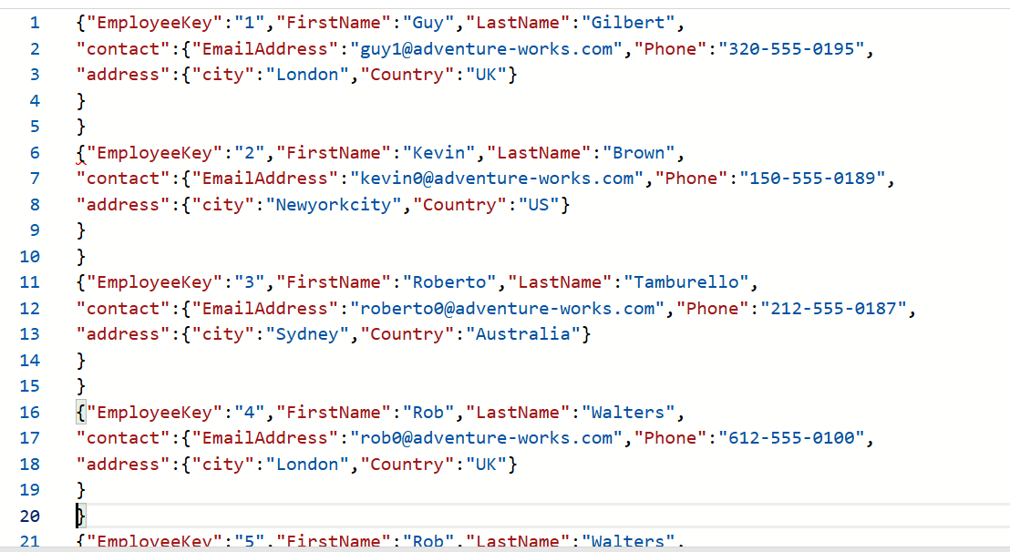

Slide 3
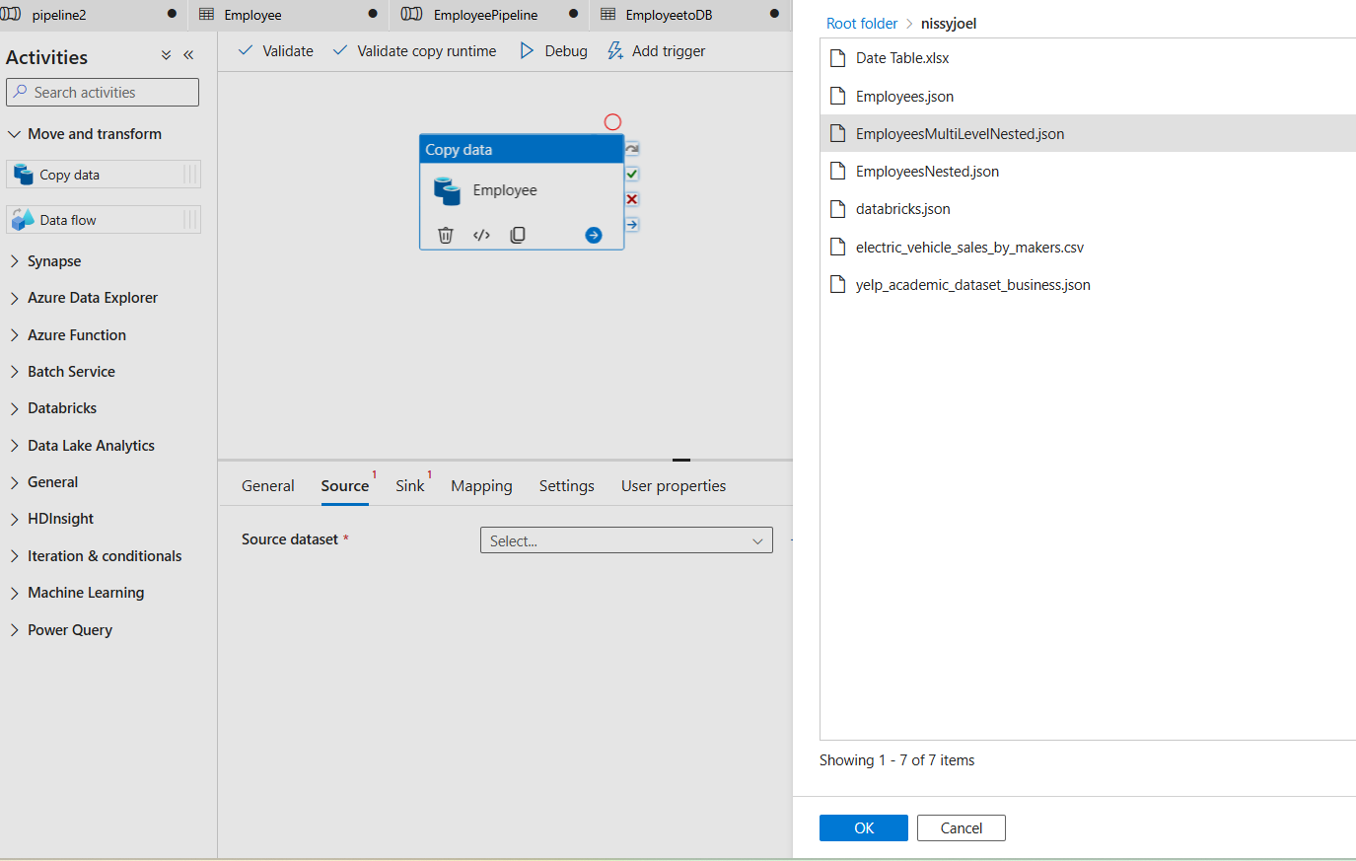
Create Pipeline and copy data

Slide 4
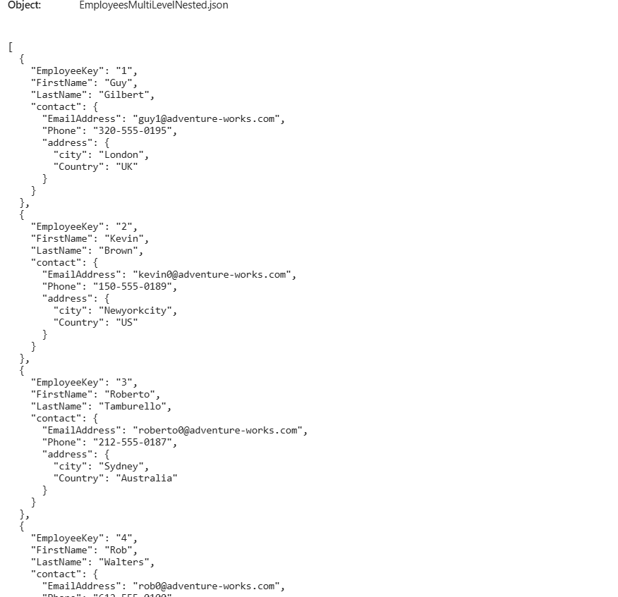
Data Preview

Slide 5
create table employeenested(
EmployeeKey int,
FirstName varchar(50),
LastName varchar(50),
EmailAddress Varchar(100),
Phone varchar(20),
city varchar(45),
country varchar(50)
)
Create table in SQL Datbase

Slide 6
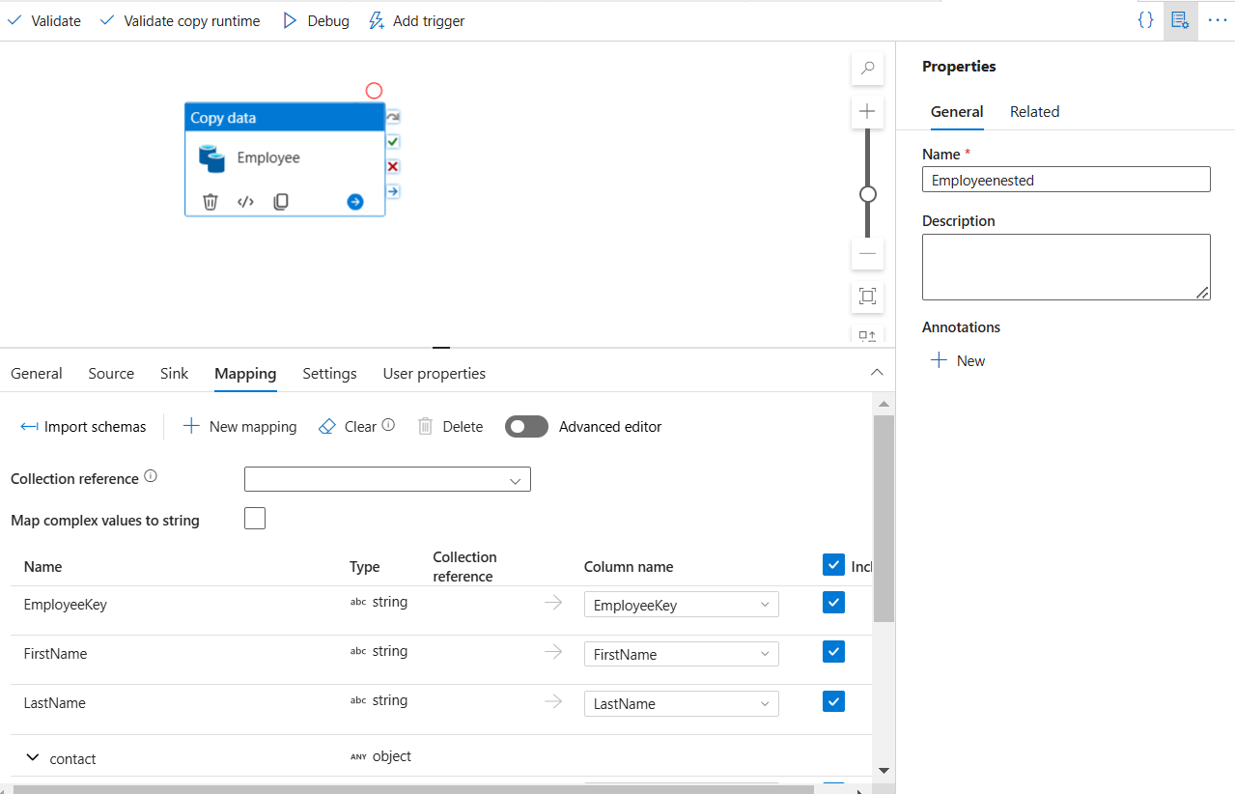
In Mapping tab
Click on Import Schemas
Map the required column names of source file and SQL table

Slide 7
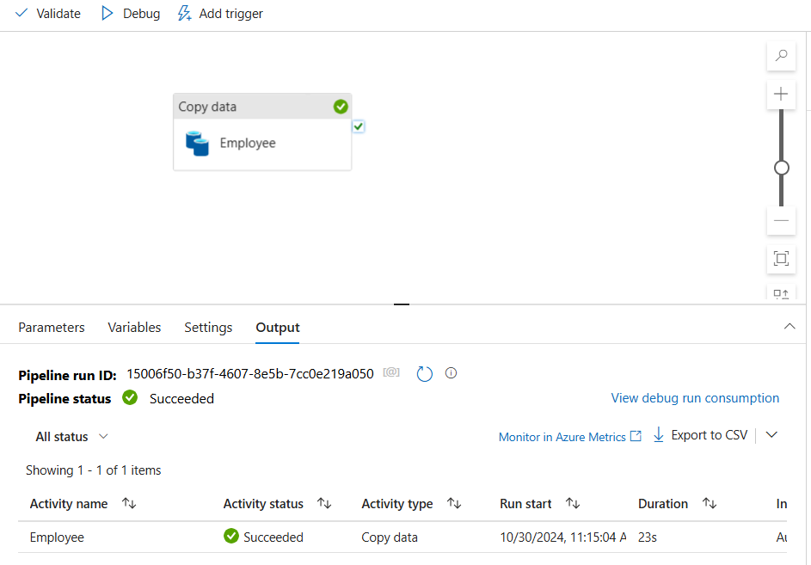
Pipeline Succeeded

Slide 8
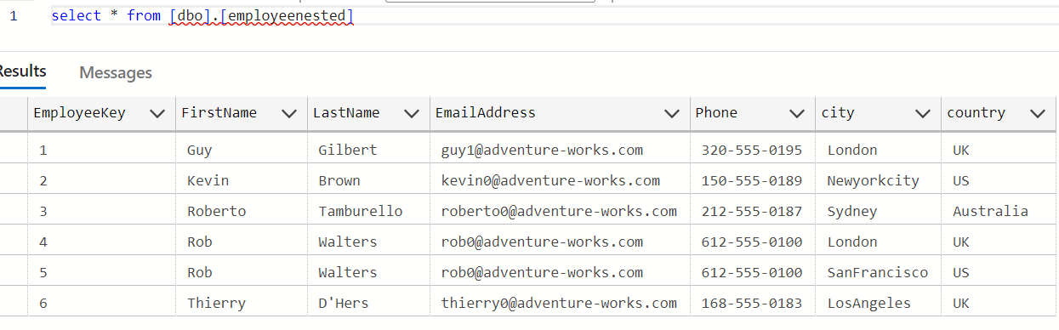
JSON file data copied to SQL Database

